Slide 1
Artist Identification using Deep Learning
Musadig Aliyev
11.12.2023

Slide 2
Table of contents
01
02
03
04
05
06
Introduction
Data Processing
Data Augmentation
Baseline Models
Transfer Learning
Results & Demo

Slide 3
Introduction
Project Objective:
This project aims to develop an artist identification system using deep Learning techniques to address the challenge of automatically identifying and categorizing artworks by their respective artists
Methodologies:
Data Augmentation
Transfer Learning

Slide 4
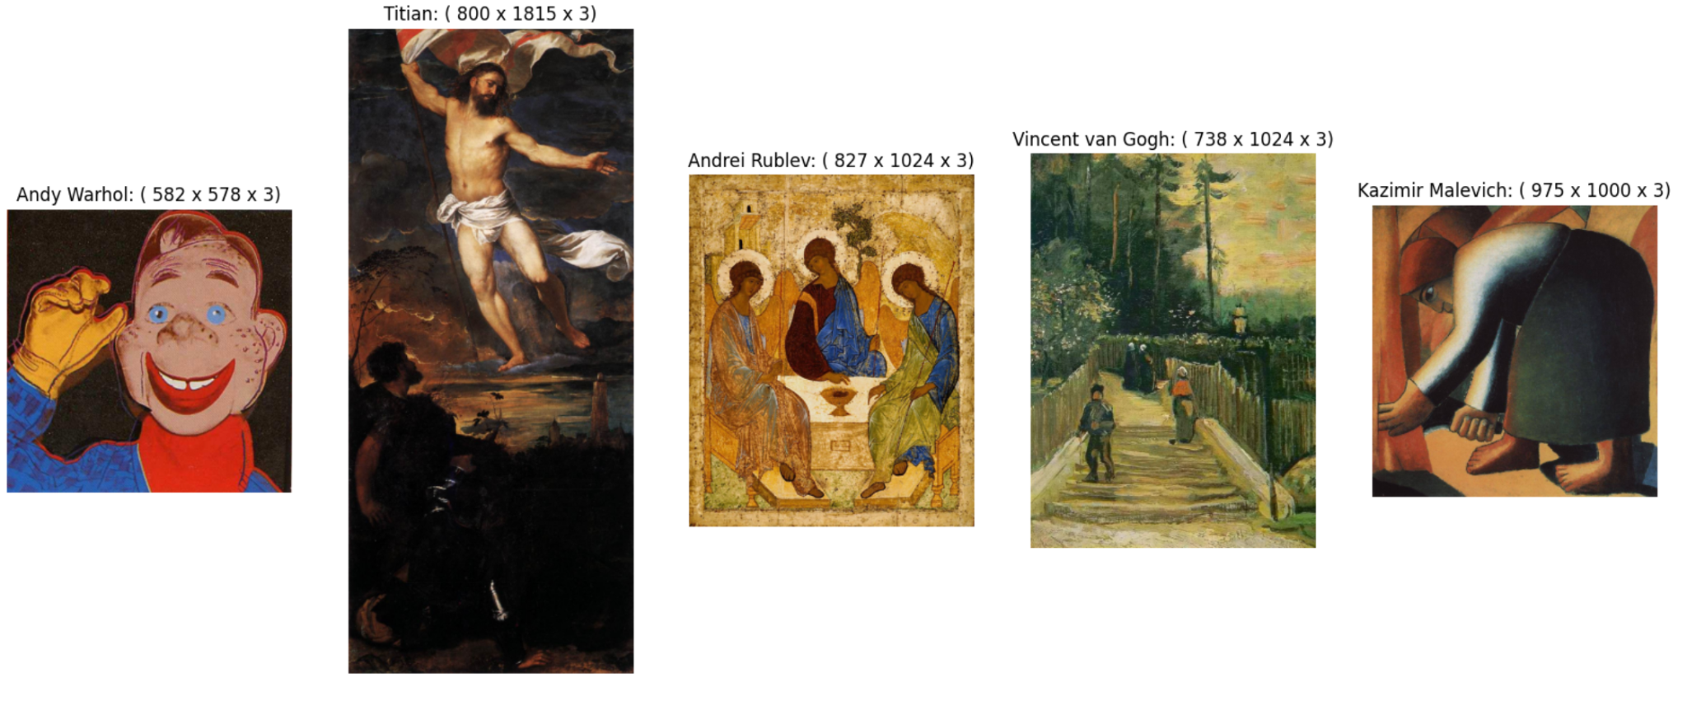
Dataset
The original dataset comprises 8,355 paintings belonging to 50 artists, collected by Icaro and made publicly available on Kaggle.

Slide 5
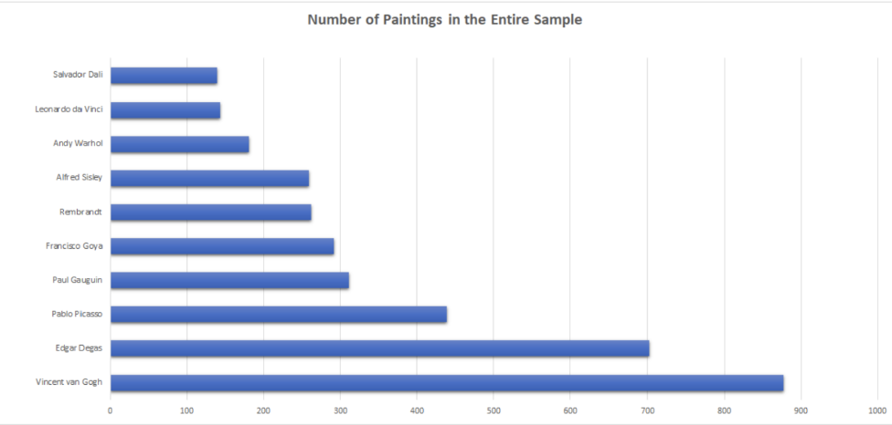
Data Processing
Dropping Duplicated Images of Authors
Rename Inconsistent Author Names
Apply Data Augmentation Techniques
Handle Data Imbalance Issue

Slide 6
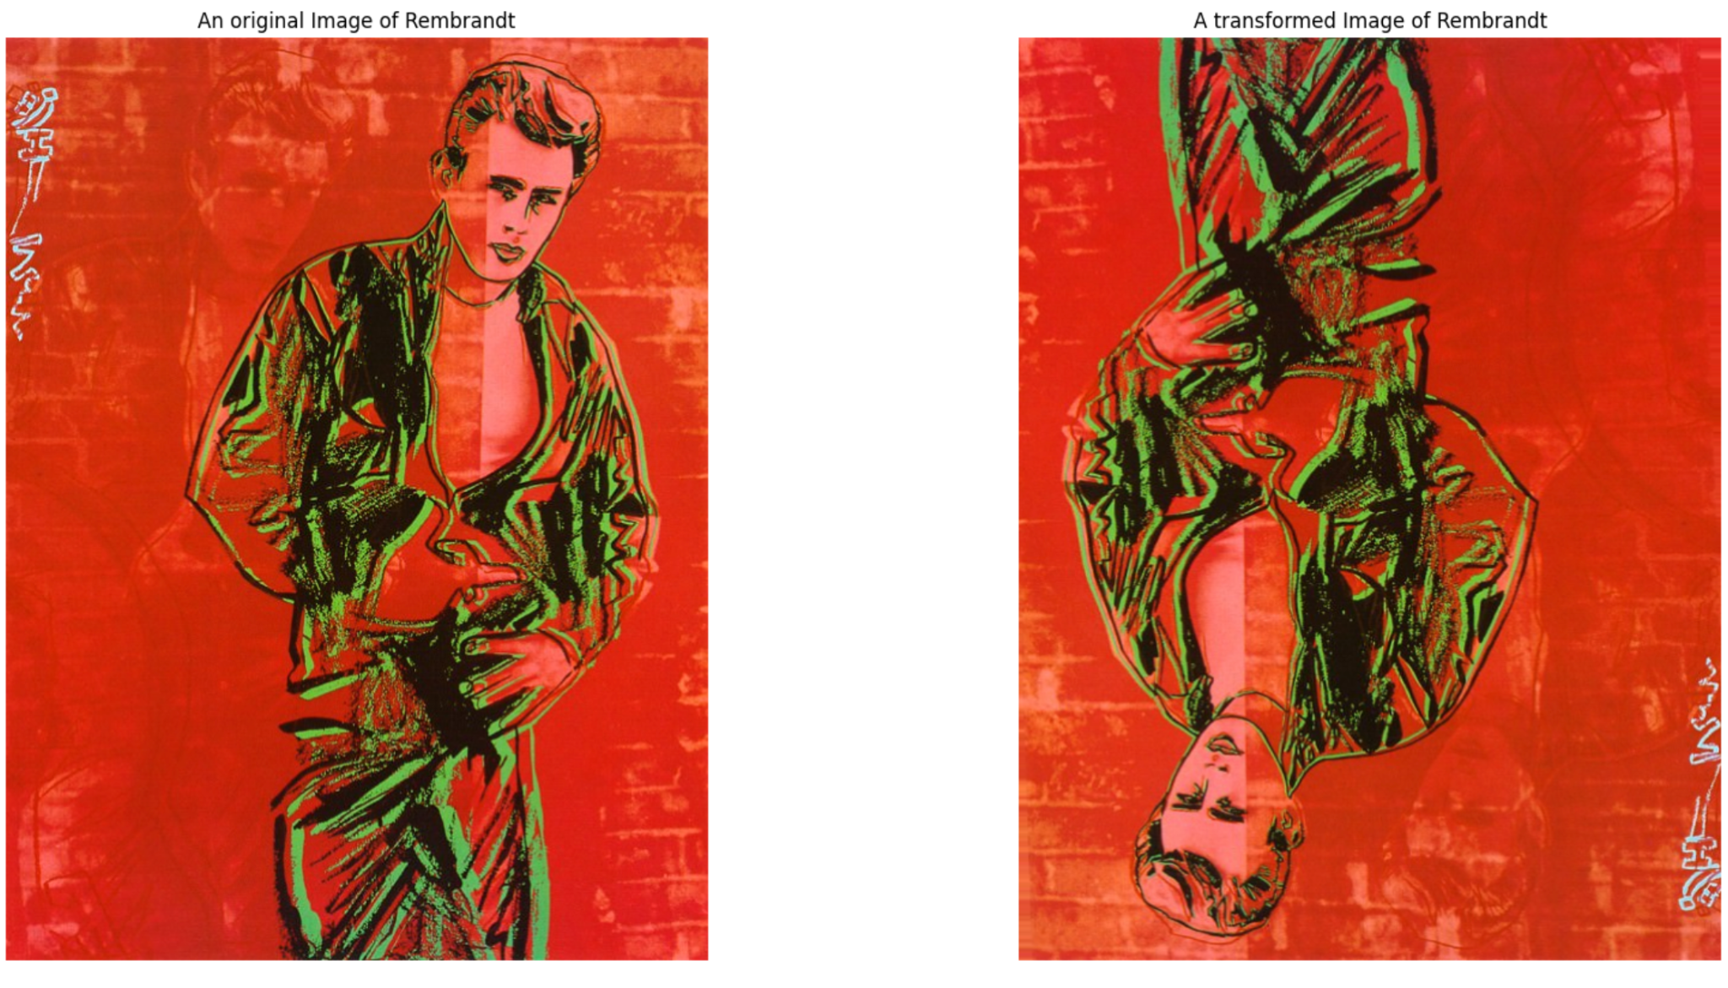
Data Augmentation
Techniques:
Shear Range: 5 ( Shearing transformations)
Zoom Range: 0.2 (Zooming transformations)
Horizontal Flip: True ( Horizontal flipping)
Vertical Flip: True (Random vertical flipping)

Slide 7
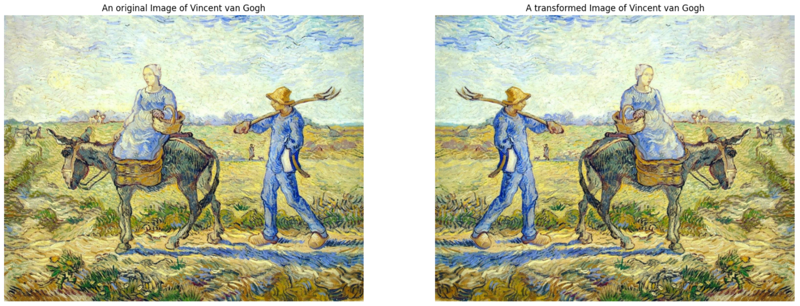
Data Augmentation (Cont)
Techniques:

Slide 8
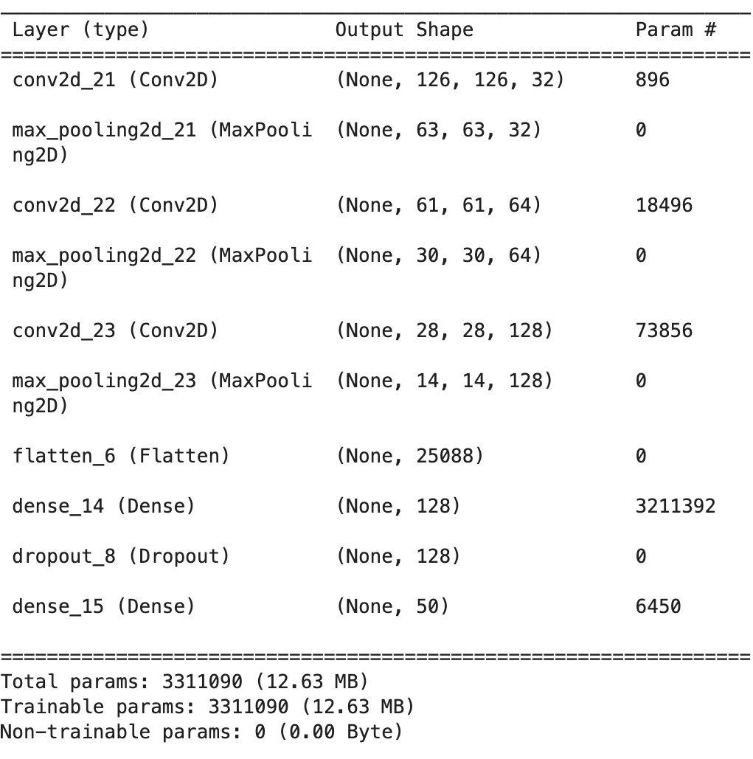
Baseline Models
Built Two Models:
Developed two models, one with data augmentation and another without.
Optimizer:
Adam
Loss Function:
Categorical Cross Entropy
Number of Epochs:
10

Slide 9
Transfer Learning
VGG16
Resnet50
VGG16 is a convolutional neural network architecture known for its simplicity and depth, consisting of 16 weight layers, including convolutional and fully connected layers.The VGG16 architecture was proposed by researchers from the Visual Geometry Group (VGG) at the University of Oxford, specifically Karen Simonyan and Andrew Zisserman.
ResNet50 is a deep convolutional neural network architecture that consists of 50 layers, developed to address the challenges of training very deep neural networks. It introduces the concept of residual learning, enabling the training of deeper models by utilizing shortcut connections that skip one or more layers, facilitating the flow of information and mitigating the vanishing gradient problem.

Slide 10
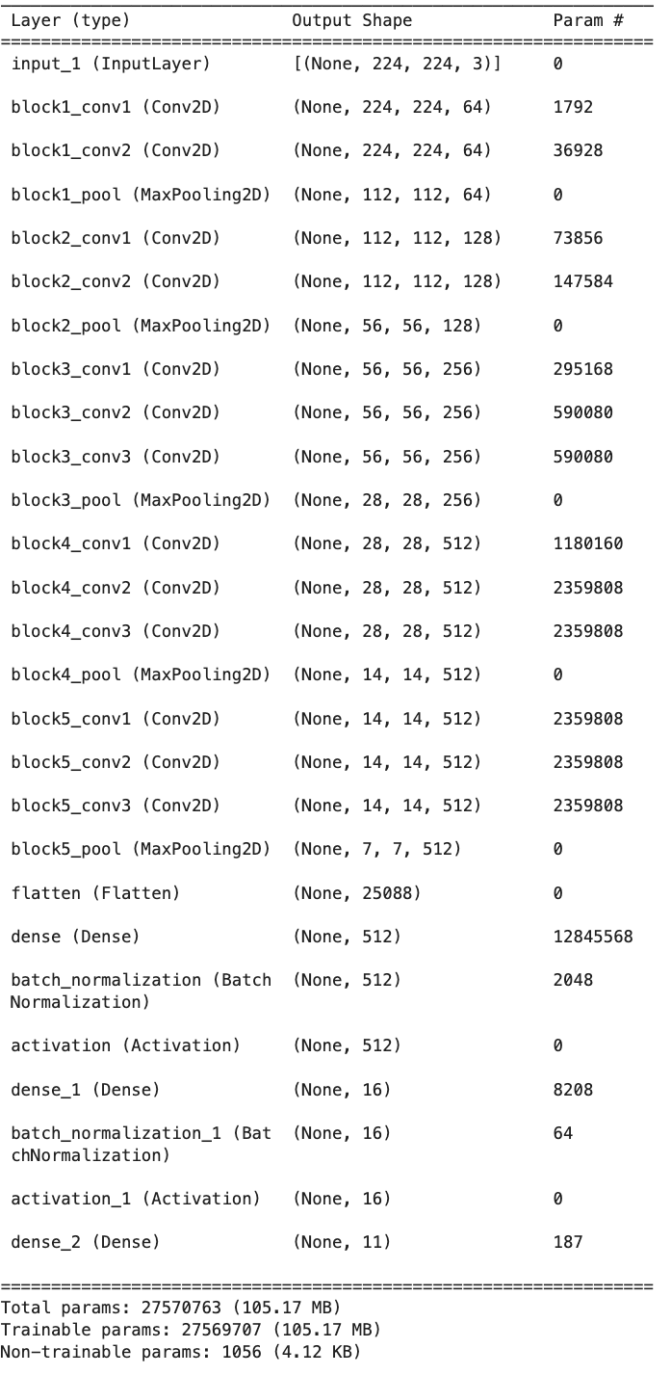
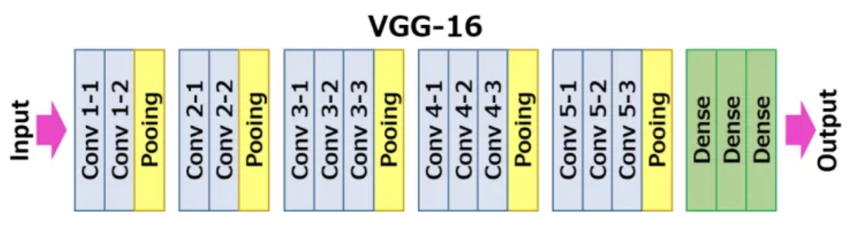
VGG-16 Architecture

Slide 11
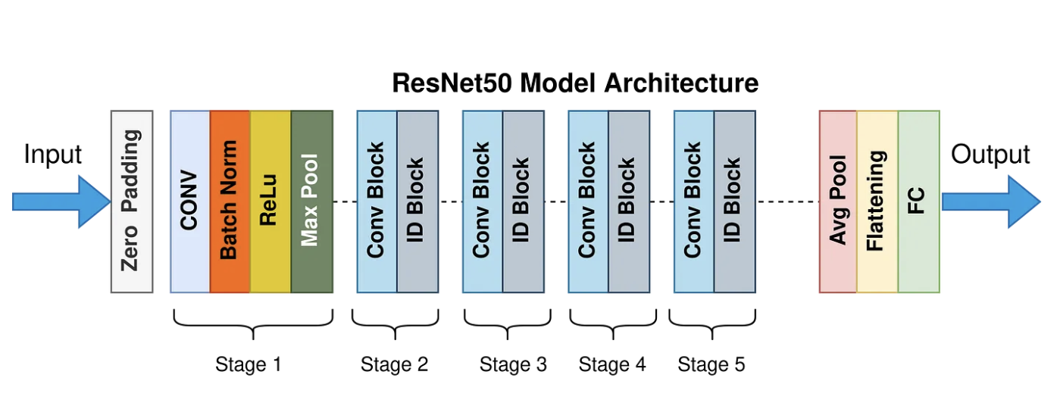
Resnet50 Architecture

Slide 12
Results and Comparisons
 | Baseline | Baseline (Augmentation) | VGG16 | Resnet50
Train | 37% | 34% | 60% | 97%
Test | 24% | 27% | 53% | 84%

Slide 13


References
[1] N. Viswanathan, “Artist Identification with Convolutional Neural Networks.” Available: http://cs231n.stanford.edu/reports/2017/pdfs/406.pdf
[2] X. Zhou, “The Power of Transfer Learning in Artist Identification.” Available: https://xingyuzhou.org/documents/transfer-learning.pdf
[3] “Painter Prediction from Artworks with Transfer Learning | IEEE Conference Publication | IEEE Xplore,” Available: https://ieeexplore.ieee.org/stamp/stamp.jsp?tp=&arnumber=9384828

Slide 14
Thank you!

